Slide 1


SQL Query Session
Phil Austin

Slide 2
Introduction
For data engineers\data scientists new to SQL Server
Query scenarios techniques and options
Mostly demos
Using SQL Server Management Studio – free SQL client from MS
Using AdventureWorks2019 database in GitHub here: https://github.com/Microsoft/sql-server-samples/releases/tag/adventureworks
Also Stack Overflow:
https://www.brentozar.com/archive/2015/10/how-to-download-the-stack-overflow-database-via-bittorrent
Interactive session – please ask questions!

Slide 3
Session agenda
Query processing
Heaps and Clustered Indexes
Clustered Columnstore Indexes
SARGable queries
Break
5. DISTINCTs
6. MAX vs RANK
7. Many joins/complex queries
8. Nolock
9. MAXDOP

Slide 4




Query processing
SQL query
Query Optimiser
Query Plan
Relational Engine
Database schema, statistics

Slide 5
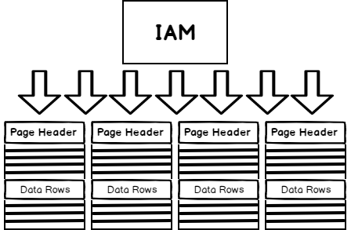
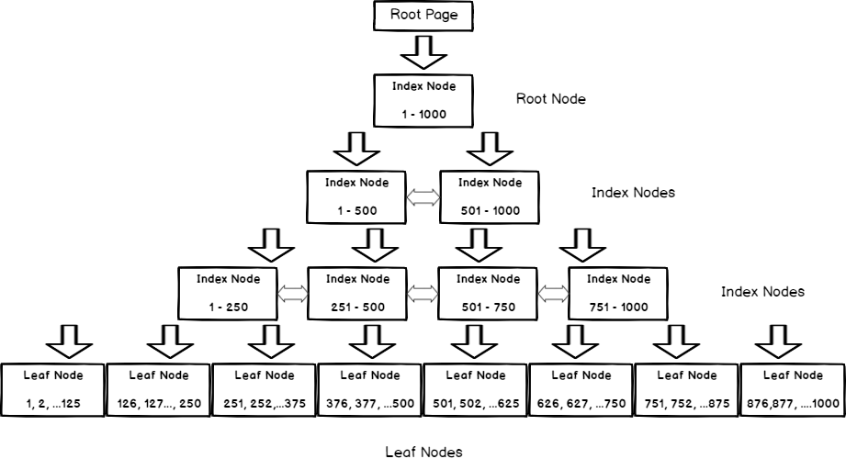
Indexing & Heaps
From: https://www.sqlshack.com/clustered-index-vs-heap/
Heaps
Clustered Index

Slide 6

Thank you!
AdventureWorks2019 : https://github.com/Microsoft/sql-server-samples/releases/tag/adventureworks
Stack Overflow: https://www.brentozar.com/archive/2015/10/how-to-download-the-stack-overflow-database-via-bittorrent
https://github.com/phil-a10/Talks
Questions?
phil.austin@adatis.co.uk
www.linkedin.com/in/phil-austin-44147415

Slide 7
Thank you! Questions?
phil.austin@adatis.co.uk
www.linkedin.com/in/phil-austin-44147415

